Slide 1
Hash Tables
Mahdi Ebrahimi
Summer 2020

Slide 2
hash tables
The national data structure of the Netherlands

Slide 3
Hash Tables
hash table
0
 | ⁞
size -1
A hash table is an array of some fixed size
Basic idea:
The goal:
Aim for constant-time find, insert, and delete "on average" under reasonable assumptions
hash function:
index = h(key)
key space (e.g., integers, strings)

Slide 4
An Ideal Hash Functions
Is fast to compute
Rarely hashes two keys to the same index
Known as collisions
Zero collisions often impossible in theory but reasonably achievable in practice
0
 | ⁞
size -1
hash function:
index = h(key)
key space (e.g., integers, strings)

Slide 5
What to Hash?
We will focus on two most common things to hash: ints and strings
If you have objects with several fields, it is usually best to hash most of the "identifying fields" to avoid collisions:
class Person { String firstName, middleName, lastName;
Date birthDate;
…
}
An inherent trade-off:
hashing-time vs. collision-avoidance
use these four values

Slide 6
Hashing Integers
key space = integers
Simple hash function:
h(key) = key % TableSize
Client: f(x) = x
Library: g(x) = f(x) % TableSize
Fairly fast and natural
Example:
TableSize = 10
Insert keys 7, 18, 41, 34, 10
0
1
2
3
4
5
6
7
8
9
10
41
34
7
18
Notes:
Note that we are ignoring the data associated with the keys

Slide 7
Hashing non-integer keys
If keys are not ints, the client must provide a means to convert the key to an int
Programming Trade-off:
Calculation speed
Avoiding distinct keys hashing to same ints

Slide 8

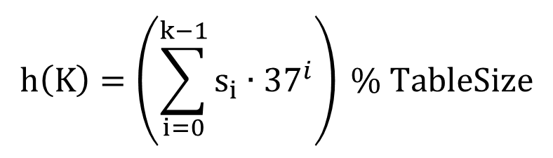
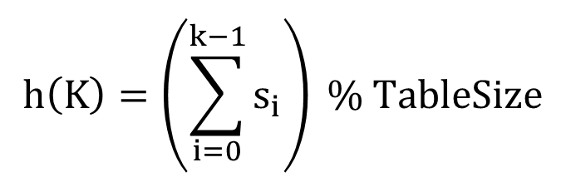
Hashing Strings
Key space K = s₀s₁s₂…s_{k-1} where s_{i} are chars: s_{i} ∈ [0, 256]
Some choices: Which ones best avoid collisions?
$$h\left(K\right)=\left(s_{0}\right) \% TableSize$$
$$h\left(K\right)=\left(\sum_{i=0}^{k−1}{s_{i}}\right) \% TableSize$$
$$h\left(K\right)=\left(\sum_{i=0}^{k−1}{s_{i}∙{37}^{i}}\right) \% TableSize$$

Slide 9
Combining Hash Functions
A few rules of thumb / tricks:
Use all 32 bits (be careful with negative numbers)
Use different overlapping bits for different parts of the hash
This is why a factor of 37^{i} works better than 256^{i}
Example: "abcde" and "ebcda"
When smashing two hashes into one hash, use bitwise-xor
bitwise-and produces too many 0 bits
bitwise-or produces too many 1 bits
Rely on expertise of others; consult books and other resources for standard hashing functions
Advanced: If keys are known ahead of time, a perfect hash can be calculated

Slide 10
Collision Resolution
Calling a State Farm agent is not an option…

Slide 11
Collision Avoidance
With (x%TableSize), number of collisions depends on
the ints inserted
TableSize
Larger table-size tends to help, but not always
Example: 70, 24, 56, 43, 10 with TableSize = 10 and TableSize = 60
Technique: Pick table size to be prime. Why?
Real-life data tends to have a pattern,
"Multiples of 61" are probably less likely than "multiples of 60"
Some collision strategies do better with prime size

Slide 12
Collision Resolution
Collision:
When two keys map to the same location in the hash table
We try to avoid it, but the number of keys always exceeds the table size
Ergo, hash tables generally must support some form of collision resolution

Slide 13
Flavors of Collision Resolution
Separate Chaining
Open Addressing
Linear Probing
Quadratic Probing
Double Hashing

Slide 14

Terminology Warning
We and the book use the terms
"chaining" or "separate chaining"
"open addressing"
Very confusingly, others use the terms
"open hashing" for "chaining"
"closed hashing" for "open addressing"
We also do trees upside-down

Slide 15
Separate Chaining
All keys that map to the same table location are kept in a linked list (a.k.a. a "chain" or "bucket")
As easy as it sounds
Example: insert 10, 22, 86, 12, 42 with h(x) = x % 10
0 | /
1 | /
2 | /
3 | /
4 | /
5 | /
6 | /
7 | /
8 | /
9 | /

Slide 16
Separate Chaining
All keys that map to the same table location are kept in a linked list (a.k.a. a "chain" or "bucket")
As easy as it sounds
Example: insert 10, 22, 86, 12, 42 with h(x) = x % 10
0
1 | /
2 | /
3 | /
4 | /
5 | /
6 | /
7 | /
8 | /
9 | /
10
/

Slide 17
Separate Chaining
All keys that map to the same table location are kept in a linked list (a.k.a. a "chain" or "bucket")
As easy as it sounds
Example: insert 10, 22, 86, 12, 42 with h(x) = x % 10
0
1 | /
2
3 | /
4 | /
5 | /
6 | /
7 | /
8 | /
9 | /
10
/
22
/

Slide 18
Separate Chaining
All keys that map to the same table location are kept in a linked list (a.k.a. a "chain" or "bucket")
As easy as it sounds
Example: insert 10, 22, 86, 12, 42 with h(x) = x % 10
0
1 | /
2
3 | /
4 | /
5 | /
6
7 | /
8 | /
9 | /
10
/
22
/
86
/

Slide 19
Separate Chaining
All keys that map to the same table location are kept in a linked list (a.k.a. a "chain" or "bucket")
As easy as it sounds
Example: insert 10, 22, 86, 12, 42 with h(x) = x % 10
0
1 | /
2
3 | /
4 | /
5 | /
6
7 | /
8 | /
9 | /
10
/
12
22
/
86
/

Slide 20
Separate Chaining
All keys that map to the same table location are kept in a linked list (a.k.a. a "chain" or "bucket")
As easy as it sounds
Example: insert 10, 22, 86, 12, 42 with h(x) = x % 10
0
1 | /
2
3 | /
4 | /
5 | /
6
7 | /
8 | /
9 | /
10
/
42
12
22
/
86
/

Slide 21
Thoughts on Separate Chaining
Worst-case time for find?
Linear
But only with really bad luck or bad hash function
Not worth avoiding (e.g., with balanced trees at each bucket)
Keep small number of items in each bucket
Overhead of tree balancing not worthwhile for small n
Beyond asymptotic complexity, some "data-structure engineering" can improve constant factors
Linked list, array, or a hybrid
Insert at end or beginning of list
Sorting the lists gains and loses performance
Splay-like: Always move item to front of list

Slide 22
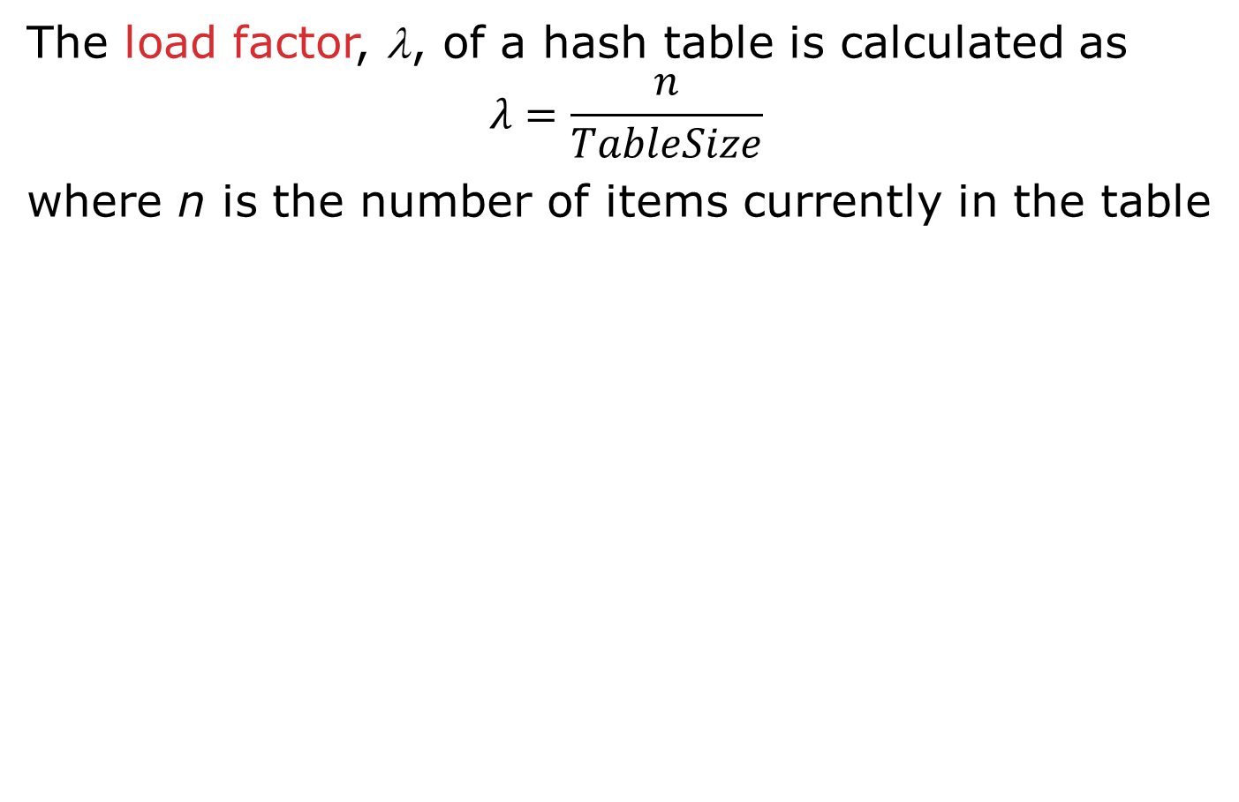
Rigorous Separate Chaining Analysis
The load factor, λ, of a hash table is calculated as
$$λ=\frac{n}{TableSize}$$ where n is the number of items currently in the table

Slide 23
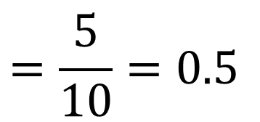
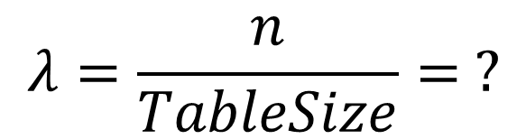
Load Factor?
0
1 | /
2
3 | /
4 | /
5 | /
6
7 | /
8 | /
9 | /
10
/
42
12
22
/
86
/
$$λ=\frac{n}{TableSize}= ?$$
$$=\frac{5}{10}=0.5$$

Slide 24
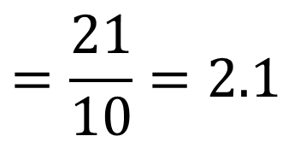
Load Factor?
0
1
2
3
4 | /
5
6
7
8
9
10
/
71
2
31
/
42
12
22
/
63
73
/
75
5
65
95
/
86
/
27
47
88
18
38
98
/
99
/
$$=\frac{21}{10}=2.1$$
$$λ=\frac{n}{TableSize}= ?$$

Slide 25
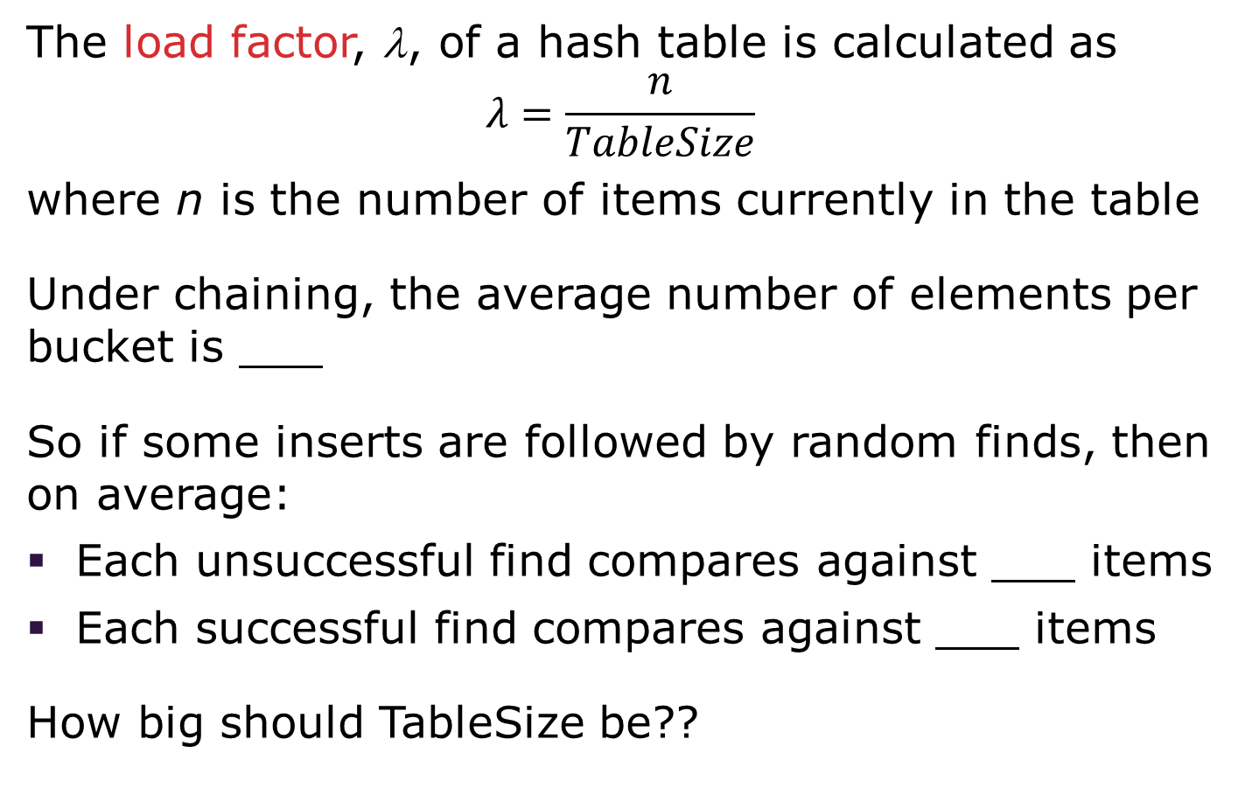
Rigorous Separate Chaining Analysis
The load factor, λ, of a hash table is calculated as
$$λ=\frac{n}{TableSize}$$ where n is the number of items currently in the table
Under chaining, the average number of elements per bucket is ___
So if some inserts are followed by random finds, then on average:
Each unsuccessful find compares against ___ items
Each successful find compares against ___ items
How big should TableSize be??

Slide 26
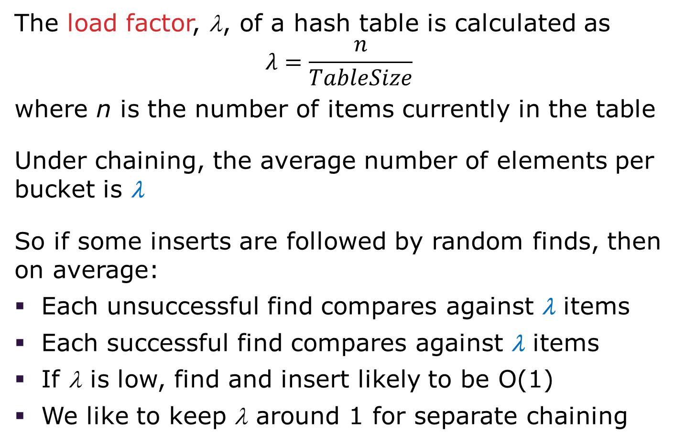
Rigorous Separate Chaining Analysis
The load factor, λ, of a hash table is calculated as
$$λ=\frac{n}{TableSize}$$ where n is the number of items currently in the table
Under chaining, the average number of elements per bucket is λ
So if some inserts are followed by random finds, then on average:
Each unsuccessful find compares against λ items
Each successful find compares against λ items
If λ is low, find and insert likely to be O(1)
We like to keep λ around 1 for separate chaining
Notes:
λ is the Greek lowercase lambda

Slide 27
Separate Chaining Deletion
Not too bad and quite easy
Find in table
Delete from bucket
Similar run-time as insert
Sensitive to underlying bucket structure
0
1 | /
2
3 | /
4 | /
5 | /
6
7 | /
8 | /
9 | /
10
/
42
12
22
/
86
/

Slide 28
Open Addressing: Linear Probing
Separate chaining does not use all the space in the table. Why not use it?
Store directly in the array cell
No linked lists or buckets
How to deal with collisions?
If h(key) is already full,
try (h(key) + 1) % TableSize. If full,
try (h(key) + 2) % TableSize. If full,
try (h(key) + 3) % TableSize. If full…
Example: insert 38, 19, 8, 79, 10
0
1
2
3
4
5
6
7
8
9

Slide 29
Open Addressing: Linear Probing
Separate chaining does not use all the space in the table. Why not use it?
Store directly in the array cell (no linked list or buckets)
How to deal with collisions?
If h(key) is already full,
try (h(key) + 1) % TableSize. If full,
try (h(key) + 2) % TableSize. If full,
try (h(key) + 3) % TableSize. If full…
Example: insert 38, 19, 8, 79, 10
0
1
2
3
4
5
6
7
8 | 38
9

Slide 30
Open Addressing: Linear Probing
Separate chaining does not use all the space in the table. Why not use it?
Store directly in the array cell (no linked list or buckets)
How to deal with collisions?
If h(key) is already full,
try (h(key) + 1) % TableSize. If full,
try (h(key) + 2) % TableSize. If full,
try (h(key) + 3) % TableSize. If full…
Example: insert 38, 19, 8, 79, 10
0
1
2
3
4
5
6
7
8 | 38
9 | 19

Slide 31
Open Addressing: Linear Probing
Separate chaining does not use all the space in the table. Why not use it?
Store directly in the array cell (no linked list or buckets)
How to deal with collisions?
If h(key) is already full,
try (h(key) + 1) % TableSize. If full,
try (h(key) + 2) % TableSize. If full,
try (h(key) + 3) % TableSize. If full…
Example: insert 38, 19, 8, 79, 10
0 | 8
1
2
3
4
5
6
7
8 | 38
9 | 19

Slide 32
Open Addressing: Linear Probing
Separate chaining does not use all the space in the table. Why not use it?
Store directly in the array cell (no linked list or buckets)
How to deal with collisions?
If h(key) is already full,
try (h(key) + 1) % TableSize. If full,
try (h(key) + 2) % TableSize. If full,
try (h(key) + 3) % TableSize. If full…
Example: insert 38, 19, 8, 79, 10
0 | 8
1 | 79
2
3
4
5
6
7
8 | 38
9 | 19

Slide 33
Open Addressing: Linear Probing
Separate chaining does not use all the space in the table. Why not use it?
Store directly in the array cell (no linked list or buckets)
How to deal with collisions?
If h(key) is already full,
try (h(key) + 1) % TableSize. If full,
try (h(key) + 2) % TableSize. If full,
try (h(key) + 3) % TableSize. If full…
Example: insert 38, 19, 8, 79, 10
0 | 8
1 | 79
2 | 10
3
4
5
6
7
8 | 38
9 | 19

Slide 34
Load Factor?
0 | 8
1 | 79
2 | 10
3
4
5
6
7
8 | 38
9 | 19
Can the load factor when using linear probing ever exceed 1.0?
Nope!!
$$λ=\frac{n}{TableSize}= ?$$
$$=\frac{5}{10}=0.5$$

Slide 35
Open Addressing in General
This is one example of open addressing
Open addressing means resolving collisions by trying a sequence of other positions in the table
Trying the next spot is called probing
We just did linear probing h(key) + i) % TableSize
In general have some probe function f and use h(key) + f(i) % TableSize
Open addressing does poorly with high load factor λ
So we want larger tables
Too many probes means we lose our O(1)

Slide 36
Open Addressing: Other Operations
insert finds an open table position using a probe function
What about find?
Must use same probe function to "retrace the trail" for the data
Unsuccessful search when reach empty position
What about delete?
Must use "lazy" deletion. Why?
Marker indicates "data was here, keep on probing"
10 | ✗ | / | 23 | / | / | 16 | ✗ | 26

Slide 37
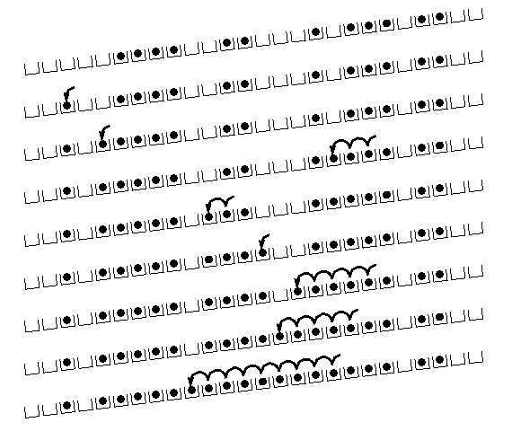
Primary Clustering
It turns out linear probing is a bad idea, even though the probe function is quick to compute (which is a good thing)
This tends to produce clusters, which lead to long probe sequences
This is called primary clustering
We saw the start of a cluster in our linear probing example
[R. Sedgewick]

Slide 38
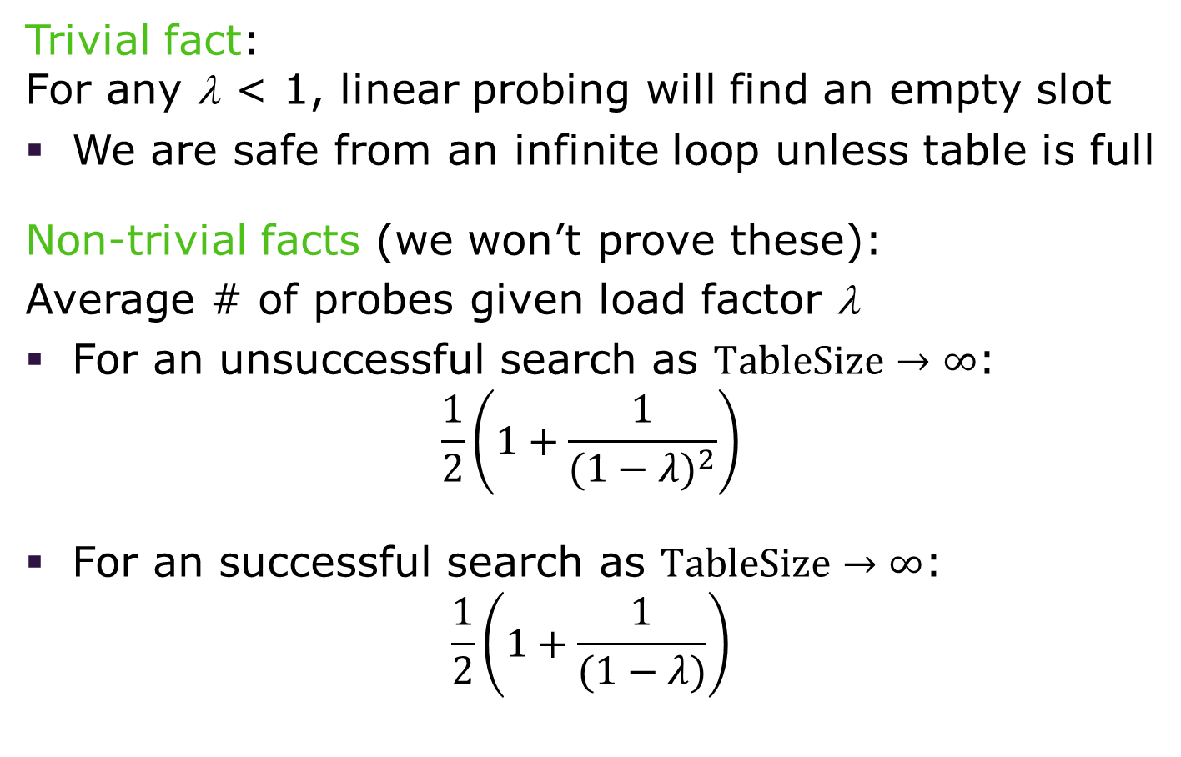
Analysis of Linear Probing
Trivial fact: For any λ < 1, linear probing will find an empty slot
We are safe from an infinite loop unless table is full
Non-trivial facts (we won’t prove these):
Average # of probes given load factor λ
For an unsuccessful search as $TableSize→∞$: $\frac{1}{2}\left(1+\frac{1}{{(1−λ)}^{2}}\right)$
For an successful search as $TableSize→∞$: $\frac{1}{2}\left(1+\frac{1}{(1−λ)}\right)$

Slide 39
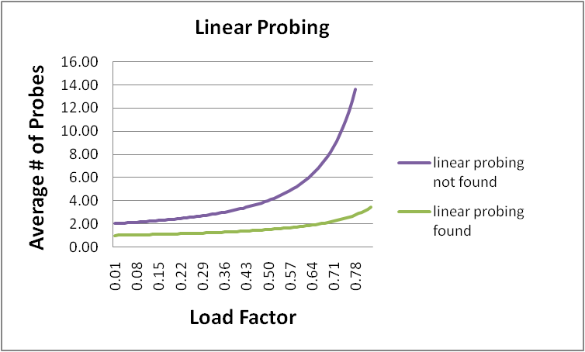
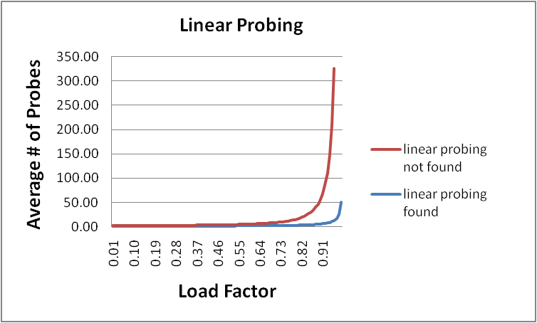
Analysis in Chart Form
Linear-probing performance degrades rapidly as the table gets full
The Formula does assumes a "large table" but the point remains
Note that separate chaining performance is linear in λ and has no trouble with λ > 1

Slide 40
Open Addressing: Quadratic Probing
We can avoid primary clustering by changing the probe function from just i to f(i)
(h(key) + f(i)) % TableSize
For quadratic probing, f(i) = i²:
0th probe: (h(key) + 0) % TableSize
1st probe: (h(key) + 1) % TableSize
2nd probe: (h(key) + 4) % TableSize
3rd probe: (h(key) + 9) % TableSize
…
i^{th} probe: (h(key) + i²) % TableSize
Intuition: Probes quickly "leave the neighborhood"

Slide 41
Quadratic Probing Example
TableSize = 10
insert(89)
0
1
2
3
4
5
6
7
8
9

Slide 42
Quadratic Probing Example
TableSize = 10
insert(89)
insert(18)
0
1
2
3
4
5
6
7
8
9 | 89

Slide 43
Quadratic Probing Example
TableSize = 10
insert(89)
insert(18)
insert(49)
0
1
2
3
4
5
6
7
8 | 18
9 | 89

Slide 44
Quadratic Probing Example
TableSize = 10
insert(89)
insert(18)
insert(49)
49 % 10 = 9 collision!
(49 + 1) % 10 = 0
insert(58)
0 | 49
1
2
3
4
5
6
7
8 | 18
9 | 89

Slide 45
Quadratic Probing Example
TableSize = 10
insert(89)
insert(18)
insert(49)
insert(58)
58 % 10 = 8 collision!
(58 + 1) % 10 = 9 collision!
(58 + 4) % 10 = 2
insert(79)
0 | 49
1
2 | 58
3
4
5
6
7
8 | 18
9 | 89

Slide 46
Quadratic Probing Example
TableSize = 10
insert(89)
insert(18)
insert(49)
insert(58)
insert(79)
79 % 10 = 9 collision!
(79 + 1) % 10 = 0 collision!
(79 + 4) % 10 = 3
0 | 49
1
2 | 58
3 | 79
4
5
6
7
8 | 18
9 | 89

Slide 47
Another Quadratic Probing Example
TableSize = 7
Insert:
76 (76 % 7 = 6)
40 (40 % 7 = 5)
48 (48 % 7 = 6)
5 (5 % 7 = 5)
55 (55 % 7 = 6)
47 (47 % 7 = 5)
0
1
2
3
4
5
6

Slide 48
Another Quadratic Probing Example
TableSize = 7
Insert:
76 (76 % 7 = 6)
40 (40 % 7 = 5)
48 (48 % 7 = 6)
5 (5 % 7 = 5)
55 (55 % 7 = 6)
47 (47 % 7 = 5)
0
1
2
3
4
5
6 | 76

Slide 49
Another Quadratic Probing Example
TableSize = 7
Insert:
76 (76 % 7 = 6)
40 (40 % 7 = 5)
48 (48 % 7 = 6)
5 (5 % 7 = 5)
55 (55 % 7 = 6)
47 (47 % 7 = 5)
0
1
2
3
4
5 | 40
6 | 76

Slide 50
Another Quadratic Probing Example
TableSize = 7
Insert:
76 (76 % 7 = 6)
40 (40 % 7 = 5)
48 (48 % 7 = 6)
5 (5 % 7 = 5)
55 (55 % 7 = 6)
47 (47 % 7 = 5)
0 | 48
1
2
3
4
5 | 40
6 | 76

Slide 51
Another Quadratic Probing Example
TableSize = 7
Insert:
(76 % 7 = 6)
(40 % 7 = 5)
48 (48 % 7 = 6)
5 (5 % 7 = 5)
55 (55 % 7 = 6)
47 (47 % 7 = 5)
0 | 48
1
2 | 5
3
4
5 | 40
6 | 76

Slide 52
Another Quadratic Probing Example
TableSize = 7
Insert:
76 (76 % 7 = 6)
40 (40 % 7 = 5)
48 (48 % 7 = 6)
5 (5 % 7 = 5)
55 (55 % 7 = 6)
47 (47 % 7 = 5)
0 | 48
1
2 | 5
3 | 55
4
5 | 40
6 | 76

Slide 53
Another Quadratic Probing Example
TableSize = 7
Insert:
76 (76 % 7 = 6)
40 (40 % 7 = 5)
48 (48 % 7 = 6)
5 (5 % 7 = 5)
55 (55 % 7 = 6)
47 (47 % 7 = 5)
(47 + 1) % 7 = 6 collision!
(47 + 4) % 7 = 2 collision!
(47 + 9) % 7 = 0 collision!
(47 + 16) % 7 = 0 collision!
(47 + 25) % 7 = 2 collision!
0 | 48
1
2 | 5
3 | 55
4
5 | 40
6 | 76
Will we ever get a 1 or 4?!?

Slide 54
Another Quadratic Probing Example
insert(47) will always fail here. Why?
For all n, (5 + n²) % 7 is 0, 2, 5, or 6
Proof uses induction and
(5 + n²) % 7 = (5 + (n - 7)²) % 7
In fact, for all c and k,
(c + n²) % k = (c + (n - k)²) % k
0 | 48
1
2 | 5
3 | 55
4
5 | 40
6 | 76

Slide 55
From Bad News to Good News
After TableSize quadratic probes, we cycle through the same indices
The good news:
For prime T and 0 ≤ i, j ≤ T/2 where i ≠ j, (h(key) + i²) % T ≠ (h(key) + j²) % T
If TableSize is prime and λ < ½, quadratic probing will find an empty slot in at most TableSize/2 probes
If you keep λ < ½, no need to detect cycles as we just saw

Slide 56
Clustering Reconsidered
Quadratic probing does not suffer from primary clustering as the quadratic nature quickly escapes the neighborhood
But it is no help if keys initially hash the same index
Any 2 keys that hash to the same value will have the same series of moves after that
Called secondary clustering
We can avoid secondary clustering with a probe function that depends on the key: double hashing

Slide 57
Open Addressing: Double Hashing
Idea:
Given two good hash functions h and g, it is very unlikely that for some key, h(key) == g(key)
Ergo, why not probe using g(key)?
For double hashing, f(i) = i ⋅ g(key):
0th probe: (h(key) + 0 ⋅ g(key)) % TableSize
1st probe: (h(key) + 1 ⋅ g(key)) % TableSize
2nd probe: (h(key) + 2 ⋅ g(key)) % TableSize
…
i^{th} probe: (h(key) + i ⋅ g(key)) % TableSize
Crucial Detail:
We must make sure that g(key) cannot be 0

Slide 58
Double Hashing
T = 10 (TableSize)
Hash Functions:
h(key) = key mod T
g(key) = 1 + ((key/T) mod (T-1))
0
1
2
3
4
5
6
7
8
9
Insert these values into the hash table in this order. Resolve any collisions with double hashing:
13
28
33
147
43

Slide 59
Double Hashing
T = 10 (TableSize)
Hash Functions:
h(key) = key mod T
g(key) = 1 + ((key/T) mod (T-1))
0
1
2
3 | 13
4
5
6
7
8
9
Insert these values into the hash table in this order. Resolve any collisions with double hashing:
13
28
33
147
43

Slide 60
Double Hashing
T = 10 (TableSize)
Hash Functions:
h(key) = key mod T
g(key) = 1 + ((key/T) mod (T-1))
0
1
2
3 | 13
4
5
6
7
8 | 28
9
Insert these values into the hash table in this order. Resolve any collisions with double hashing:
13
28
33
147
43

Slide 61
Double Hashing
T = 10 (TableSize)
Hash Functions:
h(key) = key mod T
g(key) = 1 + ((key/T) mod (T-1))
0
1
2
3 | 13
4
5
6
7 | 33
8 | 28
9
Insert these values into the hash table in this order. Resolve any collisions with double hashing:
13
28
33 → g(33) = 1 + 3 mod 9 = 4
147
43

Slide 62
Double Hashing
T = 10 (TableSize)
Hash Functions:
h(key) = key mod T
g(key) = 1 + ((key/T) mod (T-1))
0
1
2
3 | 13
4
5
6
7 | 33
8 | 28
9 | 147
Insert these values into the hash table in this order. Resolve any collisions with double hashing:
13
28
33
147 → g(147) = 1 + 14 mod 9 = 6
43

Slide 63
Double Hashing
T = 10 (TableSize)
Hash Functions:
h(key) = key mod T
g(key) = 1 + ((key/T) mod (T-1))
0
1
2
3 | 13
4
5
6
7 | 33
8 | 28
9 | 147
Insert these values into the hash table in this order. Resolve any collisions with double hashing:
13
28
33
147 → g(147) = 1 + 14 mod 9 = 6
43 → g(43) = 1 + 4 mod 9 = 5
We have a problem:
3 + 0 = 3 3 + 5 = 8 3 + 10 = 13 3 + 15 = 18 3 + 20 = 23

Slide 64
Double Hashing Analysis
Because each probe is "jumping" by g(key) each time, we should ideally "leave the neighborhood" and "go different places from the same initial collision"
But, as in quadratic probing, we could still have a problem where we are not "safe" due to an infinite loop despite room in table
This cannot happen in at least one case:
For primes p and q such that 2 < q < p
h(key) = key % p
g(key) = q – (key % q)

Slide 65
Summarizing Collision Resolution
Separate Chaining is easy
find, delete proportional to load factor on average
insert can be constant if just push on front of list
Open addressing uses probing, has clustering issues as it gets full but still has reasons for its use:
Easier data representation
Less memory allocation
Run-time overhead for list nodes (but an array implementation could be faster)

Slide 66
Rehashing
When you make hash from hash leftovers…

Slide 67
Rehashing
As with array-based stacks/queues/lists
If table gets too full, create a bigger table and copy everything
Less helpful to shrink a table that is underfull
With chaining, we get to decide what "too full" means
Keep load factor reasonable (e.g., < 1)?
Consider average or max size of non-empty chains
For open addressing, half-full is a good rule of thumb

Slide 68
Rehashing
What size should we choose?
Twice-as-big?
Except that won’t be prime!
We go twice-as-big but guarantee prime
Implement by hard coding a list of prime numbers
You probably will not grow more than 20-30 times and can then calculate after that if necessary

Slide 69
Rehashing
Can we copy all data to the same indices in the new table?
Will not work; we calculated the index based on TableSize
Rehash Algorithm:
Go through old table
Do standard insert for each item into new table
Resize is an O(n) operation,
Iterate over old table: O(n)
n inserts / calls to the hash function: n ⋅ O(1) = O(n)
Is there some way to avoid all those hash function calls?
Space/time tradeoff: Could store h(key) with each data item
Growing the table is still O(n); only helps by a constant factor

Slide 70
Implementing Hashing
Reality is never as clean-cut as theory

Slide 71
Hashing and Comparing
Our use of int key can lead to us overlooking a critical detail
We do perform the initial hash on E
While chaining/probing, we compare to E which requires equality testing (compare == 0)
A hash table needs a hash function and a comparator
In Project 2, you will use two function objects
The Java library uses a more object-oriented approach: each object has an equals method and a hashCode method:
class Object {
boolean equals(Object o) {…}
int hashCode() {…}
…
}

Slide 72
Equal Objects Must Hash the Same
The Java library (and your project hash table) make a very important assumption that clients must satisfy
Object-oriented way of saying it:
If a.equals(b), then we must require
a.hashCode()==b.hashCode()
Function object way of saying it:
If c.compare(a,b) == 0, then we must require
h.hash(a) == h.hash(b)
If you ever override equals
You need to override hashCode also in a consistent way
See CoreJava book, Chapter 5 for other "gotchas" with equals

Slide 73
Comparable/Comparator Rules
We have not emphasized important "rules" about comparison for:
all our dictionaries
sorting (next major topic)
Comparison must impose a consistent, total ordering:
For all a, b, and c:
If compare(a,b) < 0, then compare(b,a) > 0
If compare(a,b) == 0, then compare(b,a) == 0
If compare(a,b) < 0 and compare(b,c) < 0, then compare(a,c) < 0

Slide 74

A Generally Good hashCode()
int result = 17; // start at a prime
foreach field f
int fieldHashcode =
boolean: (f ? 1: 0)
byte, char, short, int: (int) f
long: (int) (f ^ (f >>> 32))
float: Float.floatToIntBits(f)
double: Double.doubleToLongBits(f), then above
Object: object.hashCode( )
result = 31 * result + fieldHashcode;
return result;

Slide 75
Final Word on Hashing
The hash table is one of the most important data structures
Efficient find, insert, and delete
Operations based on sorted order are not so efficient
Useful in many, many real-world applications
Popular topic for job interview questions
Important to use a good hash function
Good distribution of key hashs
Not overly expensive to calculate (bit shifts good!)
Important to keep hash table at a good size
Keep TableSize a prime number
Set a preferable λ depending on type of hashtable

